Slide 1
TCP CLIENT SERVER Application Rahul shinde csci 511 chico state id: 006948956

Slide 2
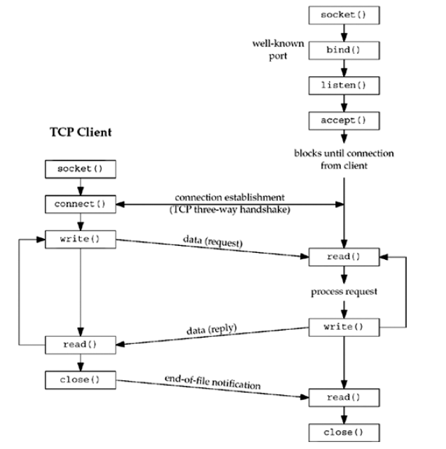
Overview

Slide 3
Socket()
Used to perform network input/output operations
Socket is the which function initiates the process.
Header file :#include <sys/socket.h>
Syntax: int socket (int family, int type, int protocol);
A socket is an endpoint of an inter-process communication flow across a computer network.
Type of socket for socket function:
Stream Socket -> SOCK_STREAM
Datagram Socket -> SOCK_DGRAM
Sequenced packet socket -> SOCK_SEQPACKET
Raw socket -> SOCK_RAW

Slide 4
Socket()
Protocol family constants for socket functions
Family | Description
AF_INET | IPv4 Protocols
AF_INET6 | IPv6 Protocols
AF_LOCAL | Unix Domain Protocols
AF_ROUTE | Routing sockets
AF_KEY | Key SocKets
Protocols of socket():
Protocols | Description
IPROTO_TCP | TCP transport protocol
IPROTO_UDP | UDP transport protocol
IPROTO_sctp | SCTP transport protocol

Slide 5
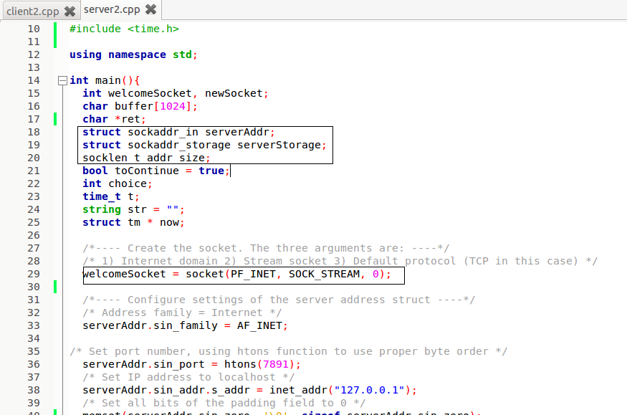
Code-snippet Socket()

Slide 6
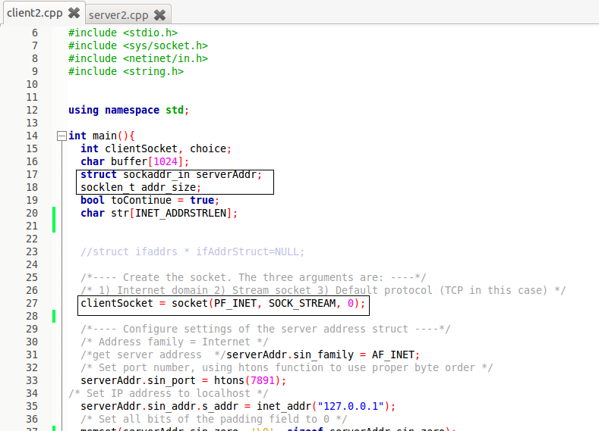
Code-snippet Socket()

Slide 7
Connect()
The connect function is used by a TCP client to establish a connection with a TCP serverThis function call initiate the process.
Header file :#include <sys/socket.h>, #include <sys/types.h>
Syntax:
int connect(int sockfd, const struct sockaddr *servaddr, socklen_t addrlen);
sockfd is a socket descriptor returned by the socket function.
The second and third arguments are a pointer to a socket address structure and its size
The socket address structure contain IP address and port number of the server

Slide 8
Connect()
Parameters:
sockfd: is a socket descriptor returned by the socket function
serv_addr is a pointer to struct sockaddr that contains destination IP address and port.
addrlen set it to sizeof(struct sockaddr).
The connect function initiates TCP's three-way handshake
If connect is successful, it returns 0. Otherwise it returns -1 and sets errno.

Slide 9
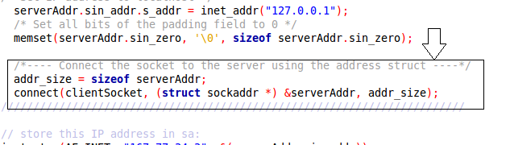
Code-snippet Connect()
Client

Slide 10
Bind()
The bind function assigns a local protocol address to a socket.
Header file :#include <sys/socket.h>
Syntax:
int bind (int sockfd, const struct sockaddr *myaddr, socklen_t addrlen);
Returns: 0 if OK and -1 on error
We use bind to tell sockets which port we want to serve.
A 0 value for port number means system will choose a random port

Slide 11
Bind()
Parameters:
sockfd: is a socket descriptor returned by the socket function.
my_addr :is a pointer to struct sockaddr that contains local IP address and port.
addrlen set it to sizeof(struct sockaddr).

Slide 12
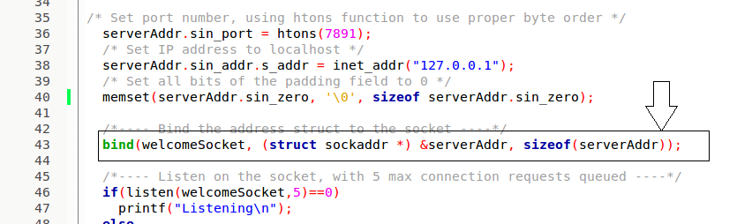
Code-snippet Bind()

Slide 13
Listen()
The listen function is called only by a TCP server and it performs two actions:
The listen function converts an unconnected socket into a passive socket, indicating that the kernel should accept incoming connection requests directed to this socket.
The second argument to this function specifies the maximum number of connections the kernel should queue for this socket.
Header file :#include <sys/socket.h>
Syntax:
int listen (int sockfd, int backlog);
Returns: 0 if OK and -1 on error

Slide 14
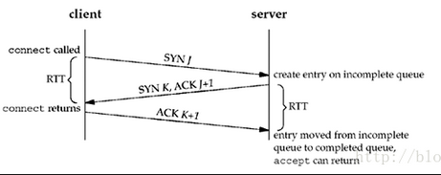
Listen()
This function is normally called after both the socket and bind functions and must be called before calling the accept function.
Parameters:
sockfd: is a socket descriptor returned by the socket function.
Backlog: it is the number of allowed connections
Three way handshake and two queues for listening socket:

Slide 15
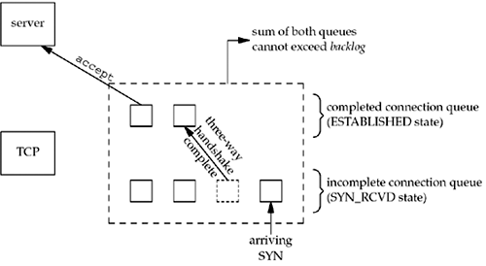
Listen()
The two queues maintained by TCP for a listening socket.

Slide 16
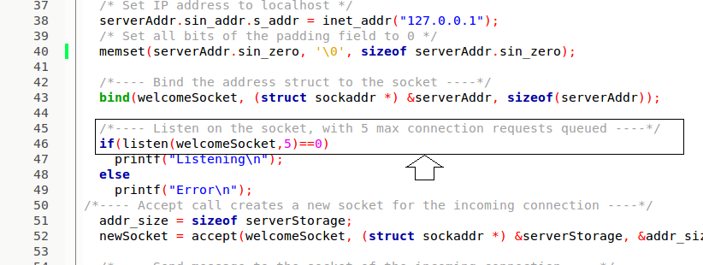
Code-snippet Listen()
Server:

Slide 17
Accept()
The accept function is called by a TCP server to return the next completed connection from the front of the completed connection queue
If the completed connection queue is empty, the process is put to sleep
Header file :#include <sys/socket.h>
Syntax:
int accept (int sockfd, struct sockaddr *cliaddr, socklen_t *addrlen);
The server accepts the connection by using the accept function.
Returns: non-negative descriptor if OK, -1 on error

Slide 18
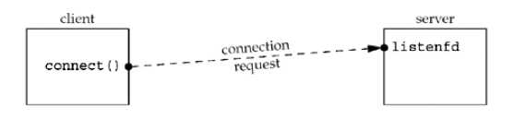
Accept()
Parameters:
sockfd: is a socket descriptor returned by the socket function.
cliaddr is a pointer to struct sockaddr that contains client IP address and port.
addrlen set it to sizeof(struct sockaddr).
Status of client/server before call to accept returns:

Slide 19
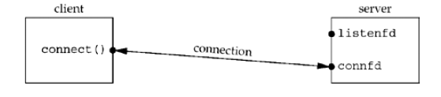
Accept()
Status of client/server after return from accept.

Slide 20
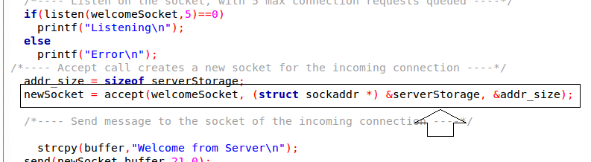
Code-snippet Accept()
Server:

Slide 21
INET_PTON()
inet_pton - convert IPv4 and IPv6 addresses from text to binary form
This function converts the character string src into a network
address structure in the af address family, then copies the network address structure to dst
Header:
#include <arpa/inet.h>
Syntax:
int inet_pton(int af, const char *src, void *dst);

Slide 22
INET_PTON()
inet_pton() returns 1 on success. 0 is returned if src does not contain a character string representing a valid network address in the specified address family.

Slide 23
INET_NTOP()
inet_ntop - convert IPv4 and IPv6 addresses from binary to text form
This function converts the character string src into a network
address structure in the af address family, then copies the network address structure to dst
Header:
#include <arpa/inet.h>
Syntax:
const char *inet_ntop(int af, const void *src,char *dst, socklen_t size);

Slide 24
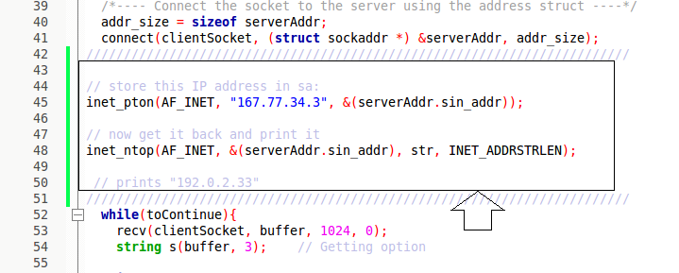
Code-snippet
INET_NTOP() and INET_PTON()

Slide 25
Read()
The read function attempts to read nbyte bytes from the file associated with the open file descriptor, fildes, into the buffer pointed to by buf.
Header file:#include <unistd.h>
Syntax:int read(int fildes, const void *buf, int nbyte);
Parameters:
fildes: is a socket descriptor returned by the socket function
buf is the buffer to read the information into
nbyte is the number of bytes to read.

Slide 26
Write()
The write function attempts to write nbyte bytes from the buffer pointed to by buf to the file associated with the open file descriptor, fildes
Header file:#include <unistd.h>
Syntax:int write(int fildes, const void *buf, int nbyte)
Parameters:
fildes: is a socket descriptor returned by the socket function.
buf is a pointer to the data you want to send.
nbyte is the number of bytes to be written. If nbyte is 0, write() will return 0 and have no other results if the file is a regular file; otherwise, the results are unspecified.

Slide 27
Memset()
The memset function is also used to set structure variables in the same way as bzero.
Header file:
#include <string.h>
Syntax
void *memset(void *s, int c, int nbyte);
This function returns a pointer to void, in fact pointer to the set memory and you need to caste it accordingly.
The memset() function fills the first n bytes of the memory area pointed to by s with the constant byte c.

Slide 28
Memset()
Parameters:
s: specifies the source to be set.
c: specifies the character to set on nbyte places..
nbyte: specifies the number of bytes to be set.
memset - fill memory with a constant byte

Slide 29
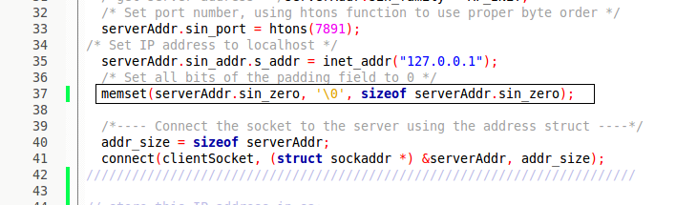
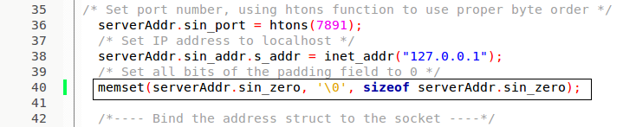
Code-snippet Memset()
Client
Server:

Slide 30
Send()
The system calls send() isused to transmit a message to another socket
Header file: #include <sys/types.h> #include <sys/socket.h>
Syntax: ssize_t send(int s, const void *buf, size_t len, int flags);
On success, these calls return the number of characters sent. On error, -1 is returned, and errno is set appropriately.

Slide 31
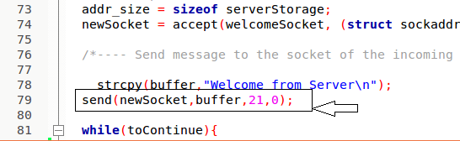
Code-snippet Send()
Server:

Slide 32
Recv()
The recv() calls are used to receive messages from a socket
It used to receive data on both connectionless and connection-oriented sockets.
The recv() call is normally used only on a connected socket
Header file:
#include <sys/types.h> ,#include <sys/socket.h>
Syntax:
ssize_t recv(int sockfd, void *buf, size_t len, int flags);
These calls return the number of bytes received, or -1 if an error occurred. The return value will be 0 when the peer has performed an orderly shutdown.

Slide 33
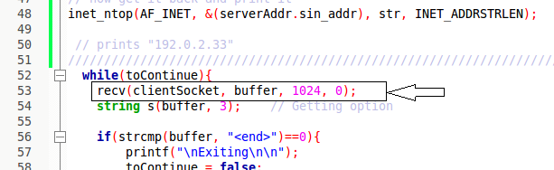
Code-snippet Recv()
Client:

Slide 34
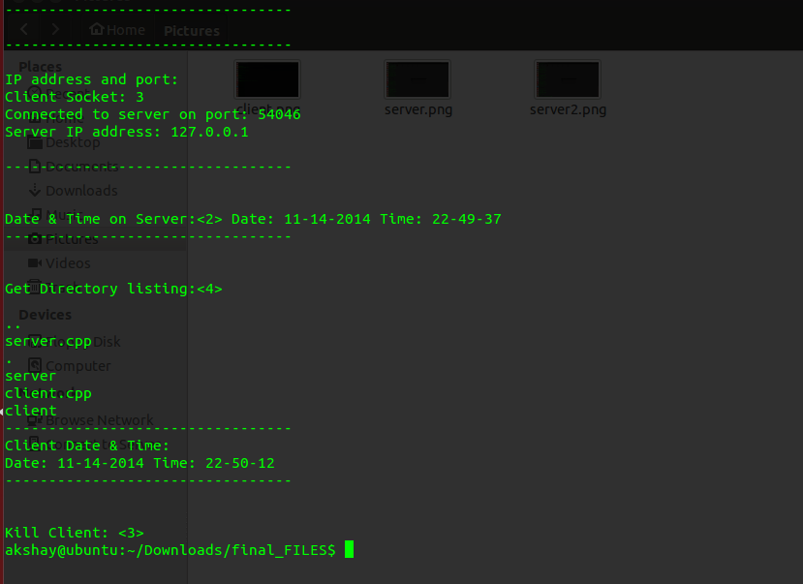
Output-Client
NOTE:While compiling we have to use g++ -std=c++11 <filename.cpp>

Slide 35
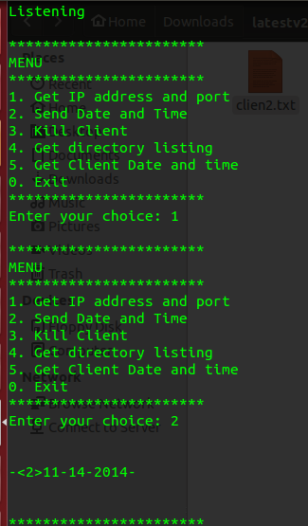
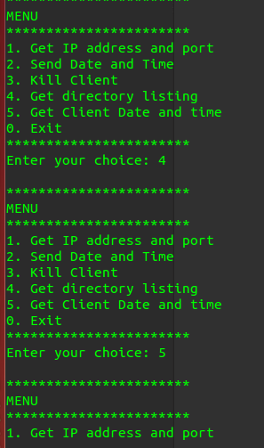
Output-Server

Slide 36
Close()
The normal Unix close function is also used to close a socket and terminate a TCP connection
Header file:
#include <unistd.h>
Syntax:
int close (int sockfd);
Both return:
0 if OK, -1 on error
The default action of close with a TCP socket is to mark the socket as closed and return to the process immediately

Slide 37
Close()
Parameters:
sockfd: is a socket descriptor returned by the socket function
This call returns 0 on success otherwise it will return -1 on error.
.

Slide 38
Getsockname()and Getpeername()
These two functions return either the local protocol address associated with a socket (getsockname) or the foreign protocol address associated with a socket (getpeername)
Header file: #include <sys/socket.h>
Syntax:
int getsockname(int sockfd, struct sockaddr *localaddr, socklen_t *addrlen);
int getpeername(int sockfd, struct sockaddr *peeraddr, socklen_t *addrlen);
Both return: 0 if OK, -1 on error

